Slide 1
Online Withdrawal Process applicable from
April 1, 2016
Authorization of Superannuation / Premature exit request by POP

Slide 2
If the withdrawal request is captured by the subscriber, POP will have to first verify and then authorize the request
If POP initiates / captures the withdrawal request, then the POP needs to authorize the request

Slide 3
This video demonstrates how POP would authorize a withdrawal request in CRA System

Slide 4
To authorize withdrawal process, the user needs to go to
https://cra-nsdl.com/CRA/

Slide 5
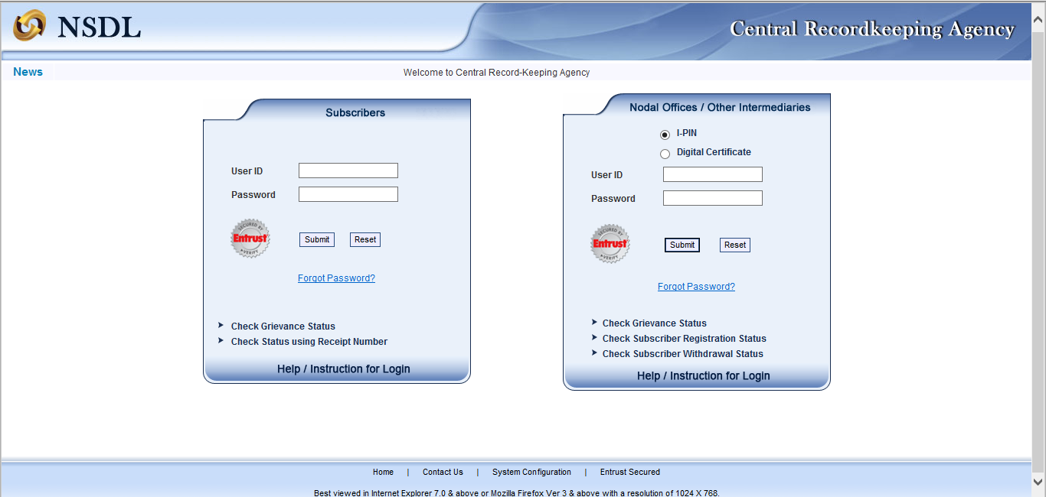
Click on Digital Certificate & Enter your User ID
Nodal Office has 2 User ID’s. The ID which is used for initiation (capturing) or verification of the withdrawal request can not be used to authorise withdrawal request

Slide 6
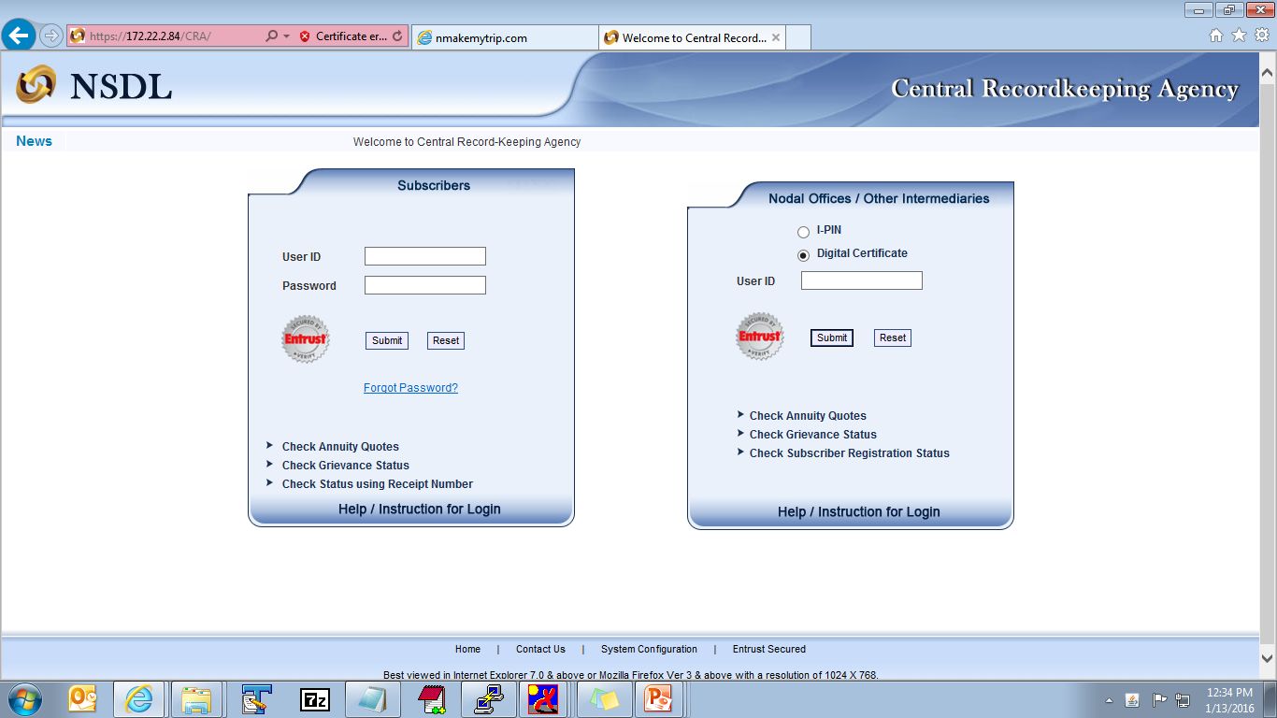
130035905

Slide 7
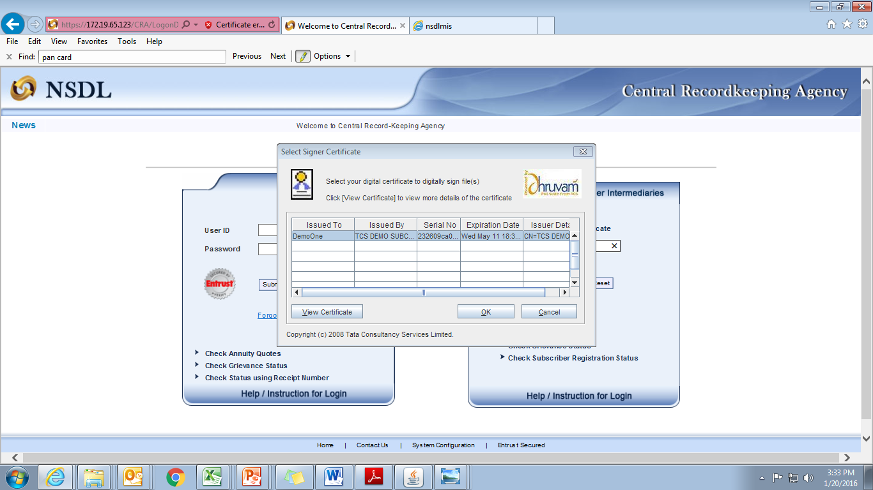

Slide 8
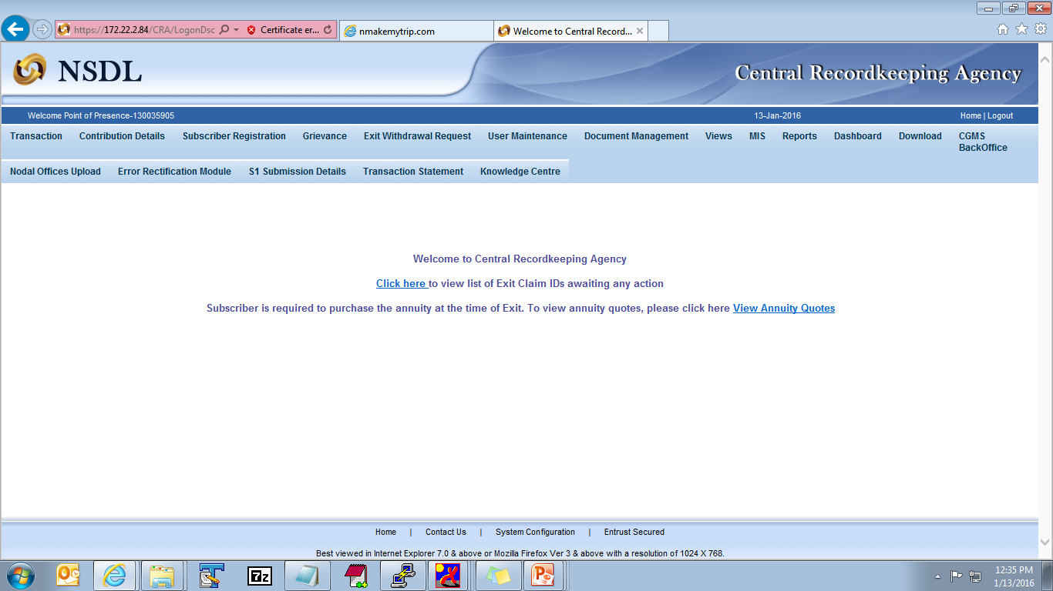
Click on “Transaction”
Click on “Authorize Transaction” to authorize withdrawal request

Slide 10
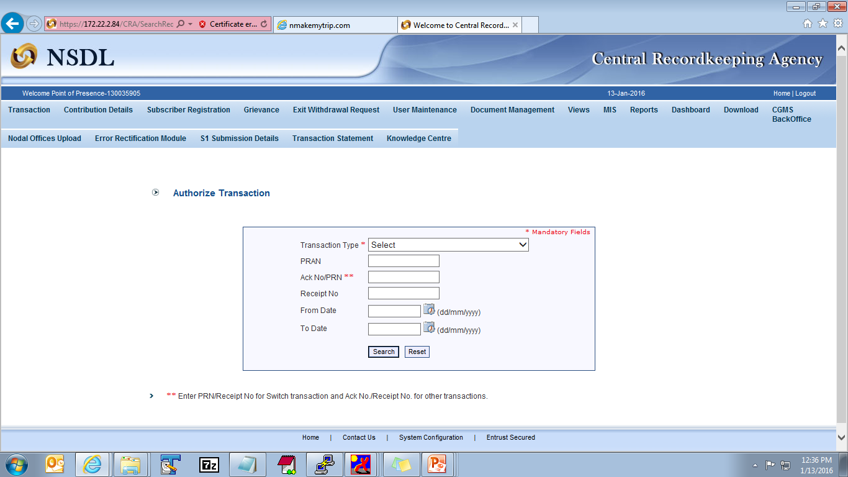
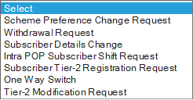
Click on Transaction type and select “withdrawal request”

Slide 11
Enter PRAN
110031211475

Slide 12
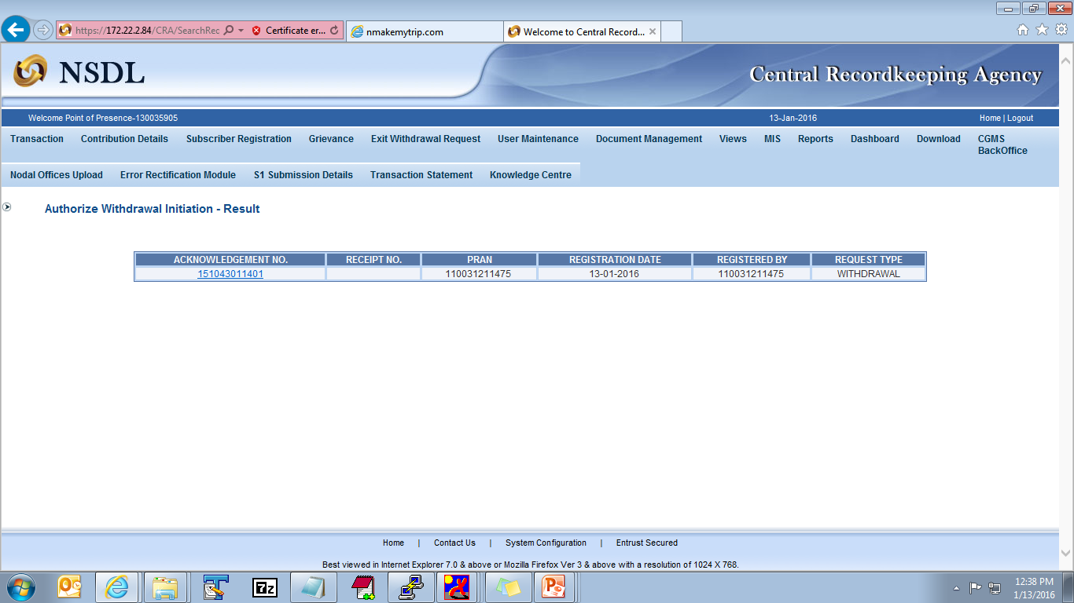
Click on hyperlink to view withdrawal request

Slide 13
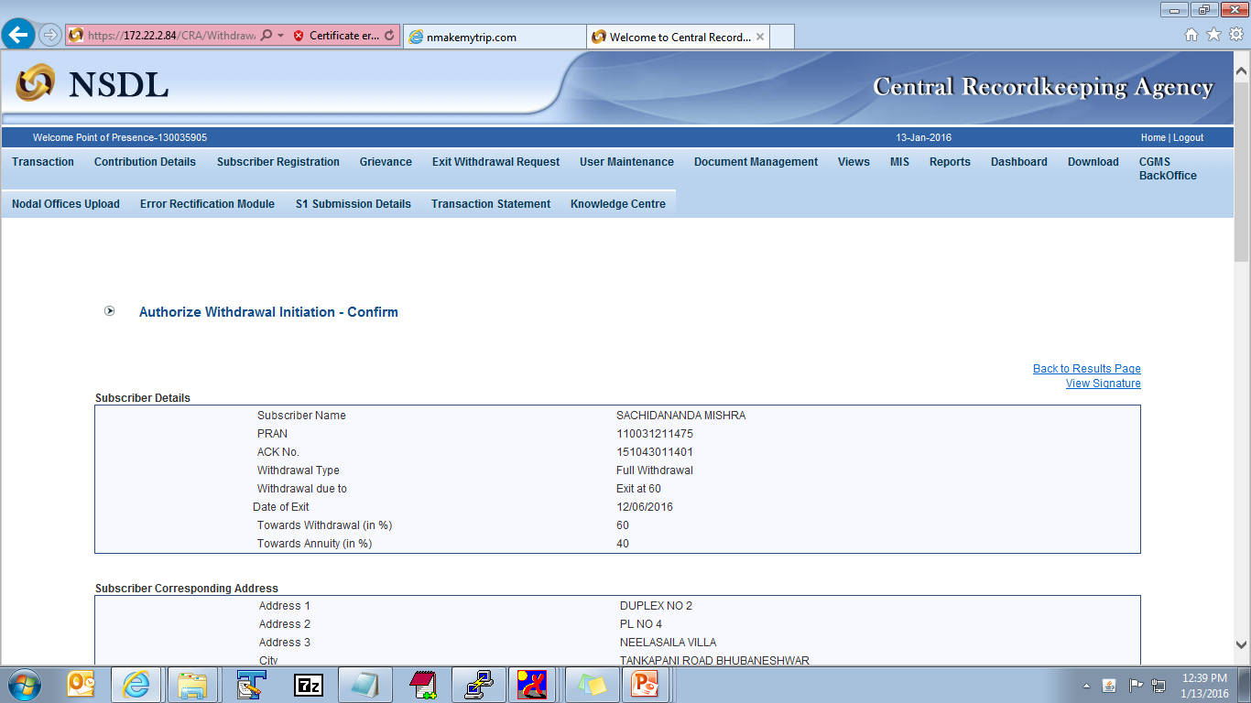

Slide 14
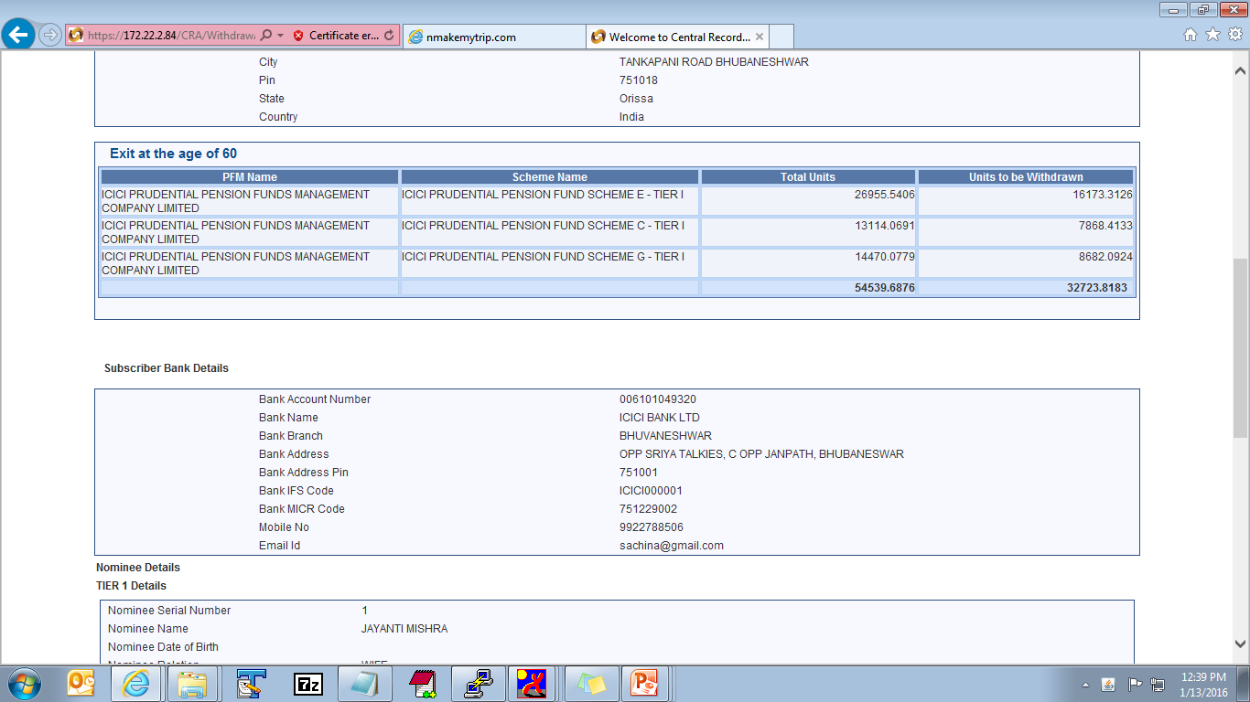

Slide 15
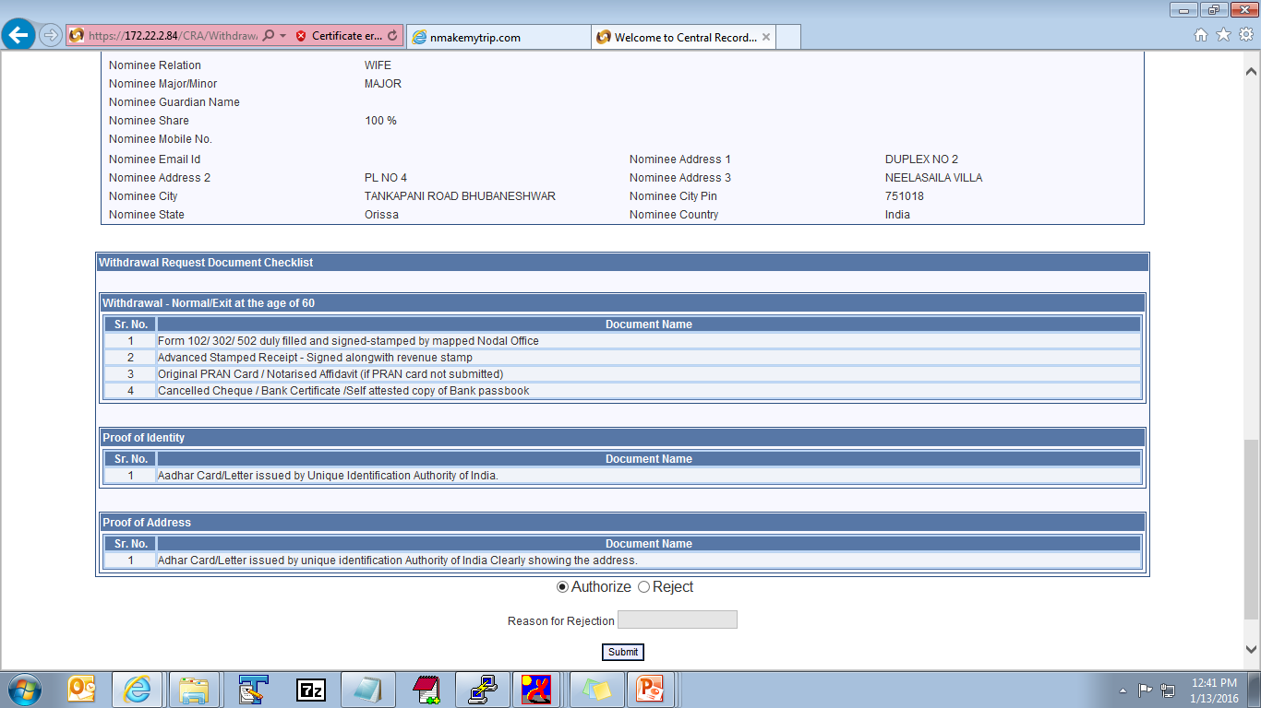
To reject the request, select “Reject” and click on “Submit” button
To authorize the request, select “Authorize” and click on “Submit” button
Reason for rejection is mandatory for all rejected cases

Slide 16
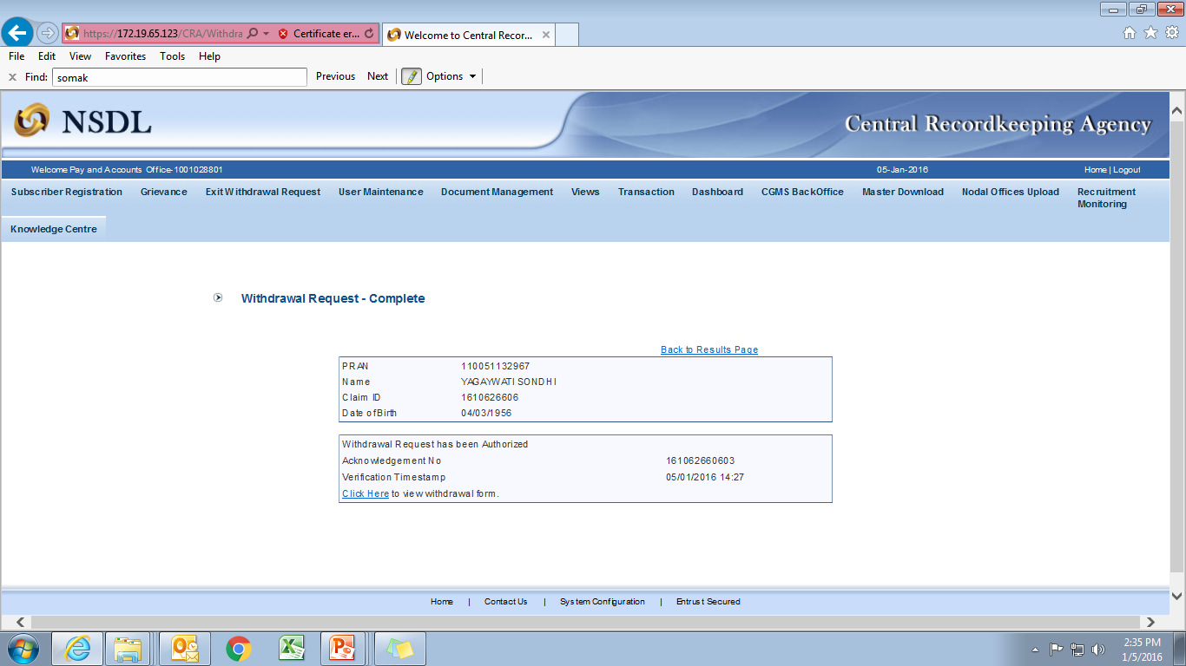

Slide 17
This step completes the online withdrawal process at Nodal Office
Withdrawal request will be processed in CRA system, once Nodal Office authorizes the online withdrawal request
Nodal Office will authorize the physical withdrawal form and documents
The system generated form along with the documents need to be forwarded to CRA for storage at the address given below:
NPS Claim Processing Cell,
1st floor, Times Tower,
Kamala Mills Compound,
Senapati Bapat Marg, Lower Parel,
Mumbai – 400 013, India.

Slide 18
Thank you for viewing the demonstration.
In case of any assistance, please contact CRA

